Slide 1
Agenda for today: Waveguides
Today we will use Lumerical MODE to examine the properties of optical waveguides.
Basic waveguide theory
Waveguide mode simulation using Lumerical MODE
a. Calculate 1D slab waveguide modes

Slide 2
Optical waveguides
Slab waveguide
Ridge waveguide
Rib waveguide
$$n_{clad}$$
$$n_{clad}$$
$$n_{clad}$$
$$n_{core}$$
$$n_{core}$$
$$n_{core}$$
$$n_{clad}$$
$$n_{clad}$$
$$n_{clad}$$
An optical waveguide has the general property that there is always a material with high refractive index ($n_{core}$) surrounded by a material with lower refractive index ($n_{clad}$)
Light is confined by total internal reflection
in ray optics picture
Need wave optics to solve for guided modes
$$n_{clad}$$
$$n_{core}$$
Step-index optical fiber
Ref: Chuang, Ch. 7

Slide 3
What is a waveguide mode?
A mode (in general) is a time-harmonic solution to Maxwell’s equations (∝ e^{iωt})
A waveguide mode is a stable propagating mode with the special property that its spatial field distribution does not change with propagation (in the absence of loss)
Waveguide modes are determined by the cross-sectional refractive index profile of the waveguide
Waveguide modes are wavelength dependent
Wang et al. Opt. Express 20, 15547-15558 (2012)

Slide 4
Waveguide mode properties / figures-of-merit
Effective index: $n_{eff}$ → $k_{z}=n_{eff}\frac{2π}{λ}$
This number depends upon waveguide design and mode. Larger number means mode is more tightly confined to waveguide core.
Modal dispersion: $n_{eff}\left(ω\right)$
Modal group velocity: $v_{g}=\frac{∂ω}{∂k_{z}}$
Velocity at which energy flows
Group velocity dispersion: $D= \frac{∂(v_{g}^{−1})}{∂λ}$
Different wavelengths travel at different speeds down waveguide! Units are time per unit wavelength per unit length. Particularly important for fiber optic cable.

Slide 5
Effective index
Each mode has an effective index that can be defined by: $k_{z}=n_{eff}\frac{2π}{λ}$
The effective index tells you how tightly the mode is confined to the waveguide core
Guided mode → $n_{clad}<n_{eff}<n_{core}$
Tightly confined to the core →$n_{eff} \sim n_{core}$
Weakly confined to the core → $n_{eff} \sim n_{clad}$
Unguided or radiating modes → $n_{eff}<n_{clad}$

Slide 6
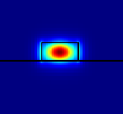
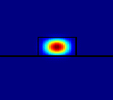
Effective index
Small effective index
Large effective index

Slide 7
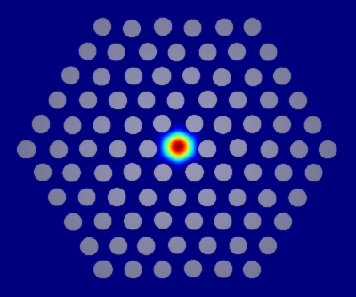
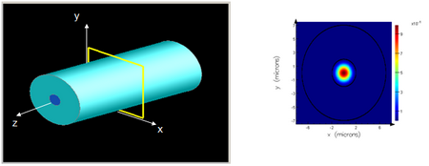
Lumerical MODE
Lumerical MODE is a finite difference frequency-domain solver that can be used to find waveguide modes
1D or 2D cross-section of a waveguide is discretized and simulated. MODE will solve for each mode and display the mode properties (e.g. $n_{eff}$, etc)
Single-mode optical fiber
Photonic crystal fiber

Slide 8
Basic waveguide theory
Time-harmonic electromagnetic fields in a source-free region must satisfy the vector Helmholtz equation
The electric-field and magnetic-field vectors in general will have components in the x, y, and z directions.
Writing out the equation for E_{x}:
$${(∇}^{2}+ω^{2}με)E=0$$
$${(∇}^{2}+ω^{2}με)H=0$$
$${(∇}^{2}+ω^{2}με)E_{x}=0$$
$$\frac{∂^{2}E_{x}}{∂x^{2}}+\frac{∂^{2}E_{x}}{∂y^{2}}+\frac{∂^{2}E_{x}}{∂z^{2}}+(ω^{2}με{)E}_{x}=0$$

Slide 9
Basic waveguide theory
Solve by separation of variables
Plug back into scalar Helmholtz equation to find:
The same can be done for the other electric and magnetic field components. Usually some field components are either exactly zero or very small and can be ignored.
$$\frac{∂^{2}E_{x}}{∂x^{2}}+\frac{∂^{2}E_{x}}{∂y^{2}}+\frac{∂^{2}E_{x}}{∂z^{2}}+(ω^{2}με{)E}_{x}=0$$
$$E_{x}=X\left(x\right)Y\left(y\right)Z(z)$$
$$X=A_{x}e^{±{jk}_{x}x}$$
$$Y=A_{y}e^{±jk_{y}y}$$
$$Z=A_{z}e^{±{jk}_{z}z}$$
$$k_{x}^{2}+k_{y}^{2}+k_{z}^{2}=k^{2}=ω^{2}με$$
Important result!

Slide 10
Solving for waveguide modes: General approach
Assume propagation in the z-direction: E, H ∝$e^{{jk}_{z}z}$
Make an educated guess for the form of the solution in each dielectric region Traveling wave: $E_{x}=E_{0}e^{jk_{x}x}e^{jk_{z}z}$ Standing wave: $E_{x}=E_{0}\cos{k_{x}x}e^{jk_{z}z}$ Decaying wave: $E_{x}=E_{0}e^{−αx}e^{jk_{z}z}$
Plug educated guess back into the Helmholtz equation and apply boundary conditions at interfaces to find characteristic equations that will allow you to solve for $k_{z}$

Slide 11
Planar slab waveguide
$$n_{clad}$$
$$μ,ε$$
x
z
Slab waveguide has two types of modes transverse electric (TE) and
transverse magnetic (TM)
$$n_{core}$$
$$μ_{1},ε_{1}$$
d/2
y
$$n_{clad}$$
$$μ,ε$$
For TE mode the E-field only has a component in the y-direction. Assuming we are trying to solve for a wave guided along the z-direction we also recognize that the structure is y-invariant
therefore we can simplify the scalar Helmholtz equation as:
$$\frac{∂^{2}E_{y}}{∂x^{2}}+\frac{∂^{2}E_{y}}{∂y^{2}}+\frac{∂^{2}E_{y}}{∂z^{2}}+(ω^{2}με{)E}_{y}=0$$
$$\frac{∂^{2}E_{y}}{∂x^{2}}+\frac{∂^{2}E_{y}}{∂z^{2}}+(ω^{2}με{)E}_{y}=0$$

Slide 12
Planar slab waveguide
$$n_{clad}$$
$$μ,ε$$
x
z
Slab waveguide has two types of modes transverse electric (TE) and
transverse magnetic (TM)
$$n_{core}$$
$$μ_{1},ε_{1}$$
d/2
y
$$n_{clad}$$
$$μ,ε$$
$$\frac{∂^{2}E_{y}}{∂x^{2}}+\frac{∂^{2}E_{y}}{∂z^{2}}+(ω^{2}με{)E}_{y}=0$$
The general solution will take the form:
$$E_{y}=e^{jk_{z}z}\left\{\begin{aligned}A_{y0}e^{±jk_{x0}x} \left|x\right|≥d/2 \\ A_{y1}e^{±jk_{x1}x} \left|x\right|≤d/2\end{aligned}\right.$$

Slide 13
Planar slab waveguide
$$n_{clad}$$
$$μ,ε$$
x
z
Slab waveguide has two types of modes transverse electric (TE) and
transverse magnetic (TM)
$$n_{core}$$
$$μ_{1},ε_{1}$$
d/2
y
$$n_{clad}$$
$$μ,ε$$
$$\frac{∂^{2}E_{y}}{∂x^{2}}+\frac{∂^{2}E_{y}}{∂z^{2}}+(ω^{2}με{)E}_{y}=0$$
Further simplify as (even solutions):
$$E_{y}=e^{jk_{z}z}\left\{\begin{aligned}A_{y0}e^{−α(\left|x\right|−d/{2)} } \left|x\right|≥d/2 \\ A_{y1}\cos{k_{x}x }\left|x\right|≤d/2\end{aligned}\right.$$
Field decays into cladding layers
Standing wave solution in core

Slide 14
Planar slab waveguide
$$n_{clad}$$
$$μ,ε$$
x
z
Slab waveguide has two types of modes transverse electric (TE) and
transverse magnetic (TM)
$$n_{core}$$
$$μ_{1},ε_{1}$$
d/2
y
$$n_{clad}$$
$$μ,ε$$
$$\frac{∂^{2}E_{y}}{∂x^{2}}+\frac{∂^{2}E_{y}}{∂z^{2}}+(ω^{2}με{)E}_{y}=0$$
Further simplify as (odd solutions):
$$E_{y}=e^{jk_{z}z}\left\{\begin{aligned}A_{y0}e^{−α(x−d/{2)} } x≥d/2 \\ A_{y1}\sin{k_{x}x }\left|x\right|≤d/2 \\ {−A}_{y0}e^{α(x+d/{2)} }x≤{−d}/2\end{aligned}\right.$$
Field decays into cladding layers
Standing wave solution in core
Field decays into cladding layers

Slide 15
Planar slab waveguide
$$n_{clad}$$
$$μ,ε$$
x
z
Slab waveguide has two types of modes transverse electric (TE) and
transverse magnetic (TM)
$$n_{core}$$
$$μ_{1},ε_{1}$$
d/2
y
$$n_{clad}$$
$$μ,ε$$
Plug back into the wave equation: $\frac{∂^{2}E_{y}}{∂x^{2}}+\frac{∂^{2}E_{y}}{∂z^{2}}+(ω^{2}με{)E}_{y}=0$
$$k_{x}^{2}+k_{z}^{2}=ω^{2}με_{1}$$
$${−α}^{2}+k_{z}^{2}=ω^{2}με$$
$$α^{2}+k_{x}^{2}=ω^{2}μ(ε_{1}−ε)$$
Need another condition on ($α, k_{x}$)

Slide 16
Planar slab waveguide
$$n_{clad}$$
$$μ,ε$$
x
z
Slab waveguide has two types of modes transverse electric (TE) and
transverse magnetic (TM)
$$n_{core}$$
$$μ_{1},ε_{1}$$
d/2
y
$$n_{clad}$$
$$μ,ε$$
Now use boundary conditions on E and H:
First, find H field using Faraday’s law:
$∇×E=−\frac{∂B}{∂t}=−μ\frac{∂H}{∂t}$
$$H=\frac{1}{jωμ_{i}}\left(−\hat{x} jk_{z}E_{y}+\hat{z}\frac{∂}{∂x}E_{y}\right)$$
($μ_{i}=μ_{1}$ inside and $μ_{i}=μ$ outside)

Slide 17
Planar slab waveguide
$$n_{clad}$$
$$μ,ε$$
x
z
Slab waveguide has two types of modes transverse electric (TE) and
transverse magnetic (TM)
$$n_{core}$$
$$μ_{1},ε_{1}$$
d/2
y
$$n_{clad}$$
$$μ,ε$$
$$H=\frac{1}{jωμ_{i}}\left(−\hat{x} jk_{z}E_{y}+\hat{z}\frac{∂}{∂x}E_{y}\right)$$
BCs: $E_{y}$ and $H_{z}$ are continuous at $\left|x\right|=d/2$. ($B_{x}$ continuous gives same condition as $E_{y}$):
Even modes:
Odd modes:
$$A_{y0}=A_{y1}\cos\left(k_{x}\frac{d}{2}\right)$$
$$\frac{α}{μ}A_{y0}=A_{y1}\frac{k_{x}}{μ_{1}}\sin\left(k_{x}\frac{d}{2}\right)$$
$$A_{y0}=A_{y1}\sin\left(k_{x}\frac{d}{2}\right)$$
$$\frac{α}{μ}A_{y0}={−A}_{y1}\frac{k_{x}}{μ_{1}}\cos\left(k_{x}\frac{d}{2}\right)$$

Slide 18
Planar slab waveguide
$$n_{clad}$$
$$μ,ε$$
x
z
Slab waveguide has two types of modes transverse electric (TE) and
transverse magnetic (TM)
$$n_{core}$$
$$μ_{1},ε_{1}$$
d/2
y
$$n_{clad}$$
$$μ,ε$$
Eliminate $A_{y0}$ and $A_{y1}$:
Even modes:
Odd modes:
$$α=\frac{μ}{μ_{1}}k_{x}\tan\left(k_{x}\frac{d}{2}\right)$$
$$α=−\frac{μ}{μ_{1}}k_{x}\cot\left(k_{x}\frac{d}{2}\right)$$

Slide 19
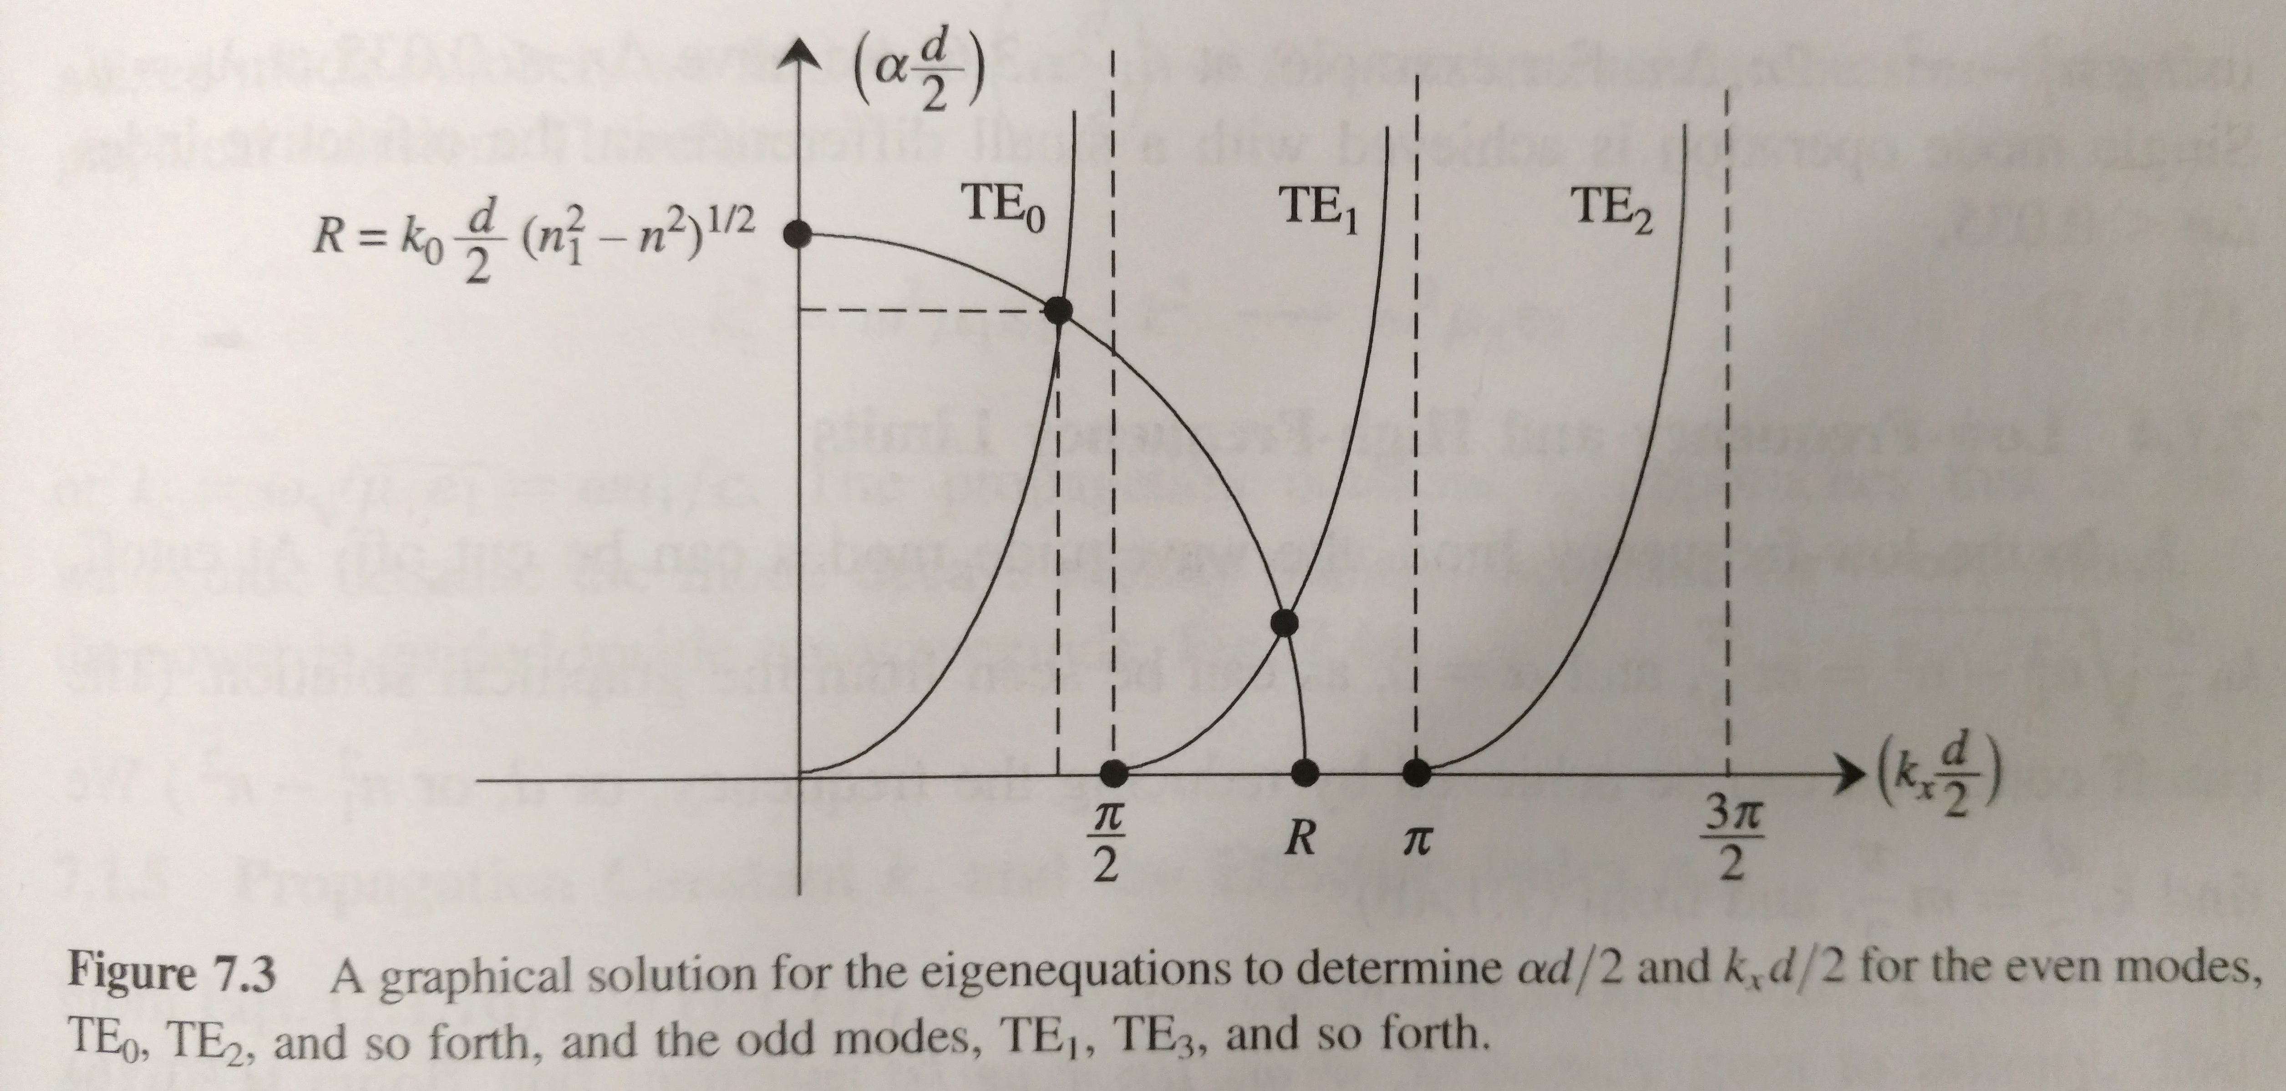
Graphical solution
Confinement factor (related to $α$) gets better for each mode as d increases
“Radius” increases as d increases
More modes are allowed
Single-mode condition:
$$k_{0}d\sqrt{n_{1}^{2}−n^{2}}<π$$
Even modes:
Odd modes:
$$α=\frac{μ}{μ_{1}}k_{x}\tan\left(k_{x}\frac{d}{2}\right)$$
$$α=−\frac{μ}{μ_{1}}k_{x}\cot\left(k_{x}\frac{d}{2}\right)$$
$$α^{2}+k_{x}^{2}=ω^{2}μ(ε_{1}−ε)$$

Slide 20
TE modes
TE₀
TE₁
TE₂
$$n_{clad}$$
$$n_{clad}$$
$$n_{clad}$$
$$n_{core}$$
$$n_{core}$$
$$n_{core}$$
$$n_{clad}$$
$$n_{clad}$$
$$n_{clad}$$
Note: TM modes can be obtained by duality in source-free media: $E→H, H→−E,μ↔ε$

Slide 21
Rectangular waveguide
Pure TE and TM modes do not exist, instead we have hybrid modes (all field components exist for each mode).
BUT, the transverse components of fields dominate and so they are often called quasi-TE and quasi-TM
Can be approximated using similar approach to slab waveguide
$$n_{1}$$
$$n_{2}>n_{1}$$
$$n_{1}$$
x
Cross-section
z
y

Slide 22
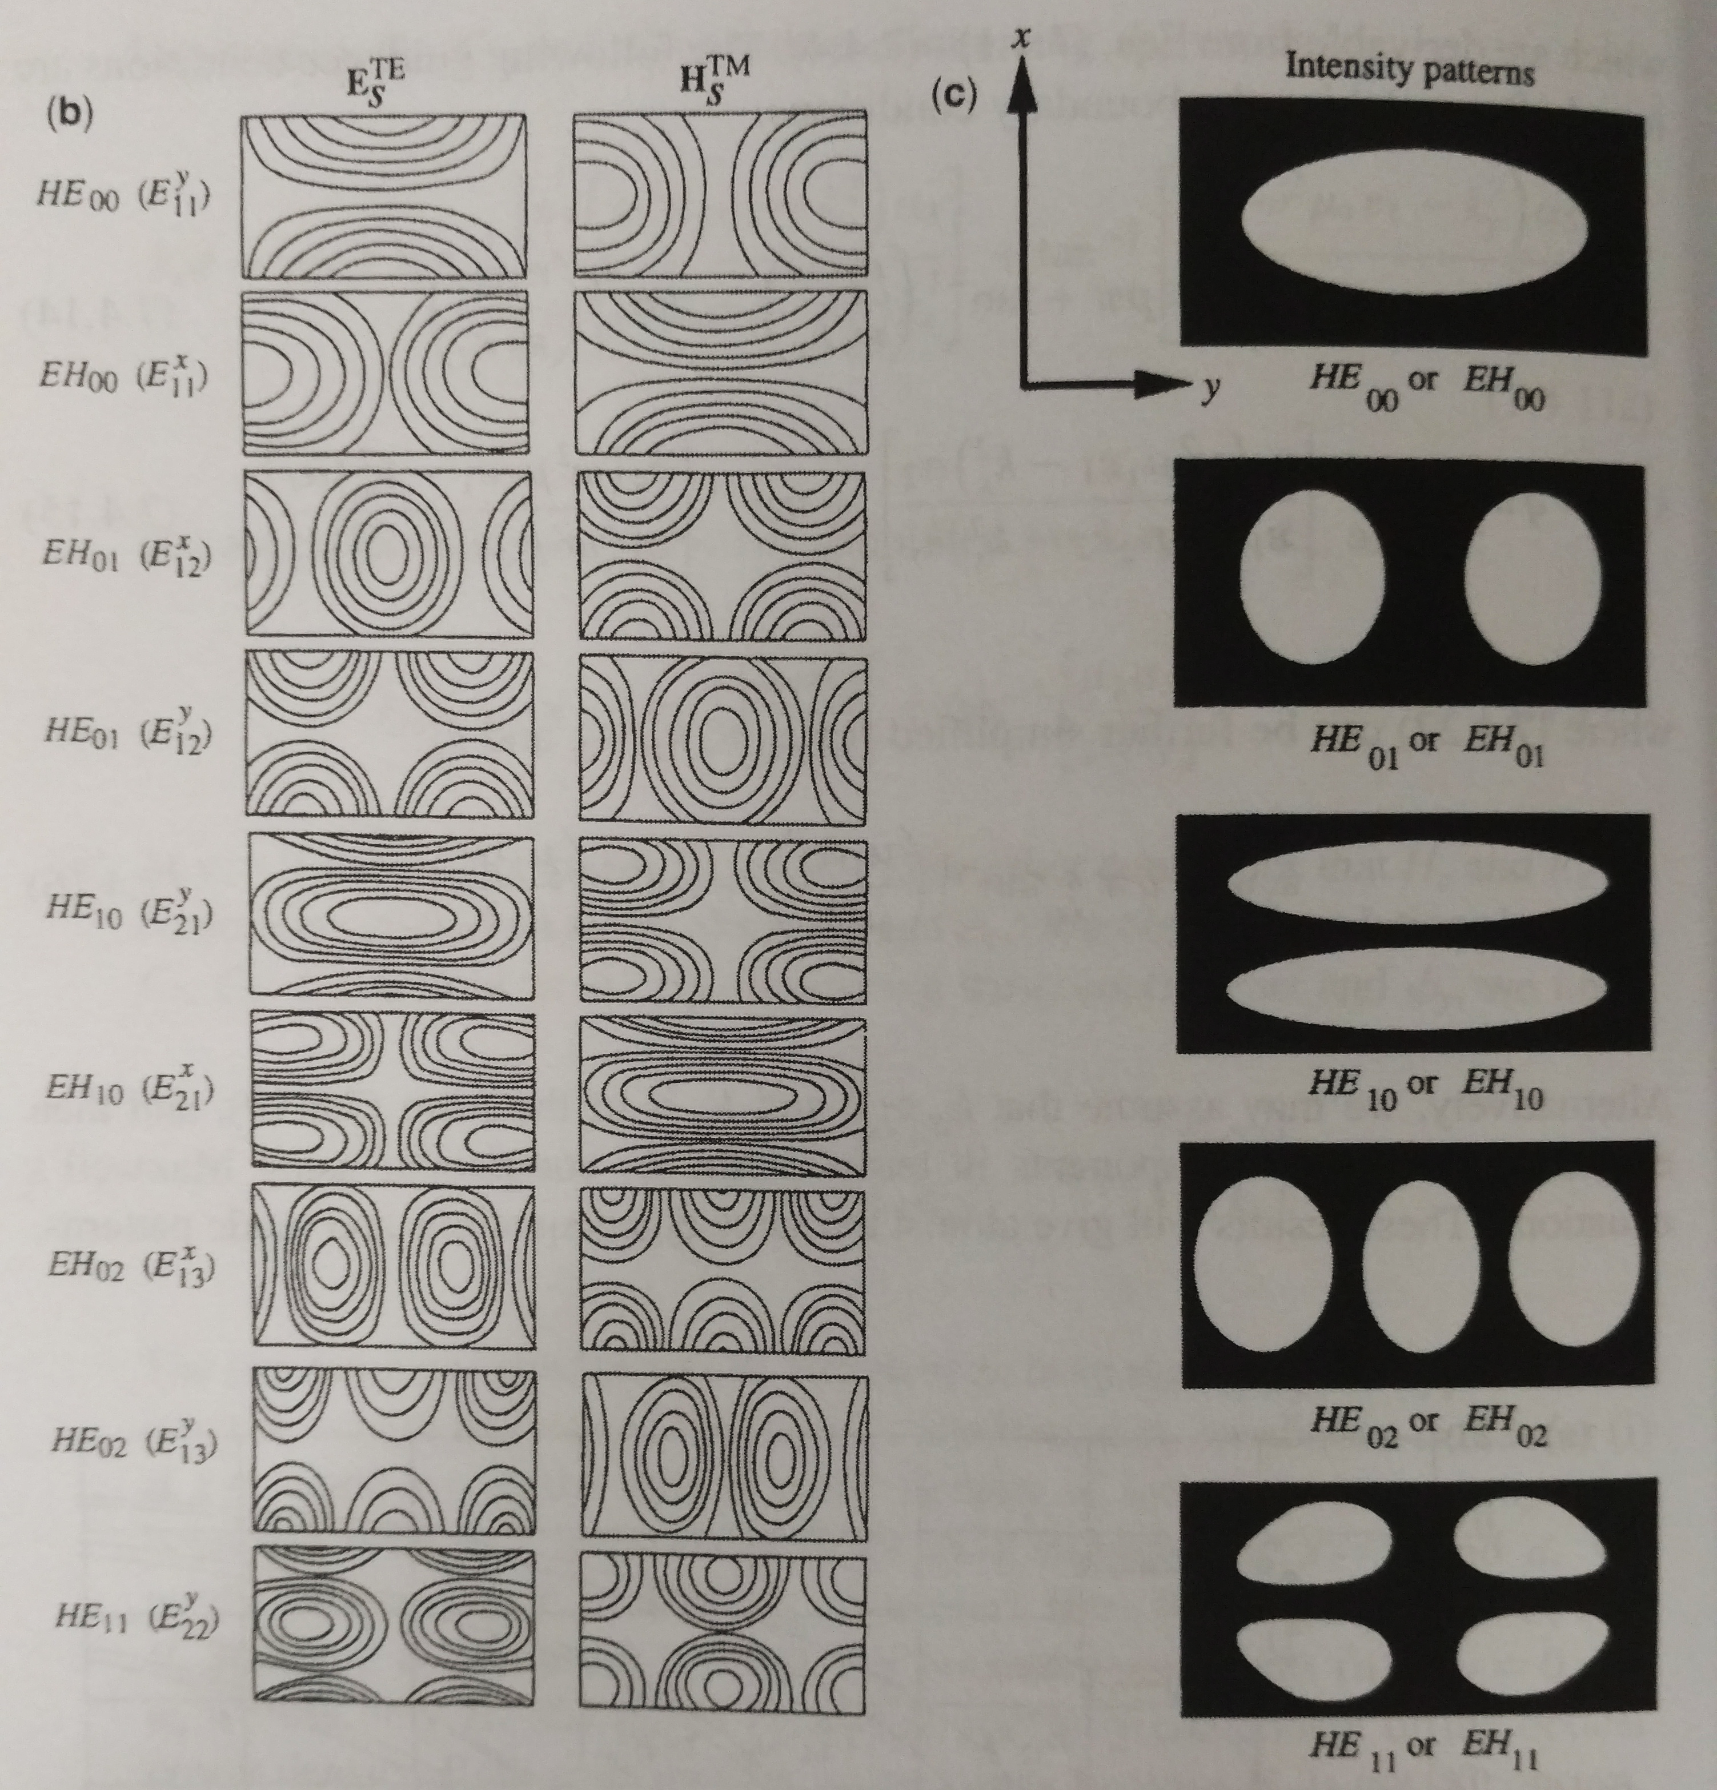
Rectangular waveguide

Slide 23
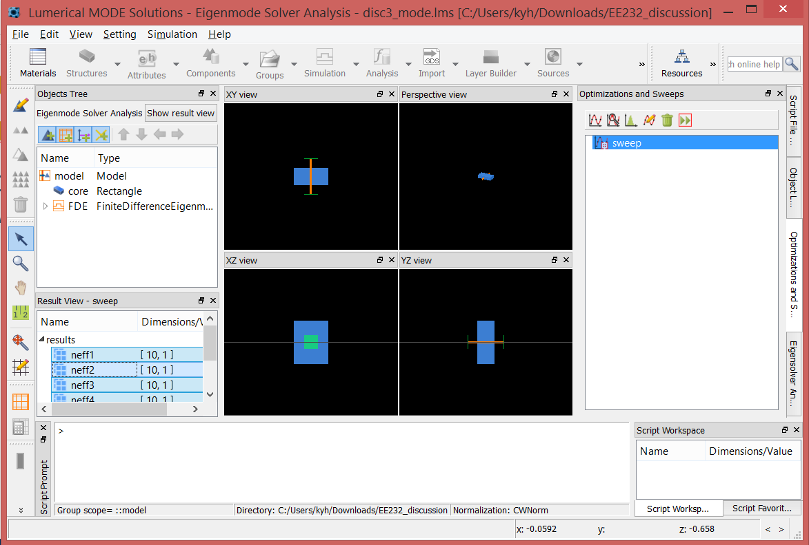
Simulating slab waveguide with Lumerical MODE
Open MODE software
Create new rectangle: Structures > Rectangle

Slide 24
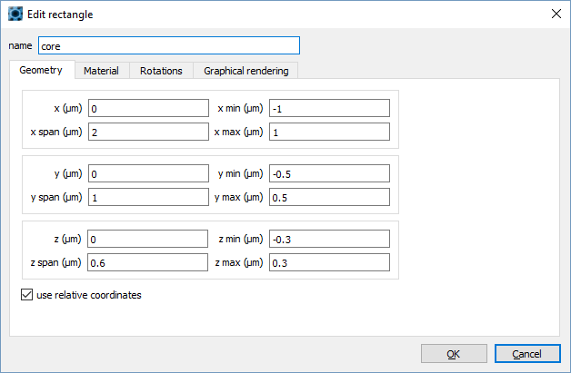
Create waveguide core

Slide 25
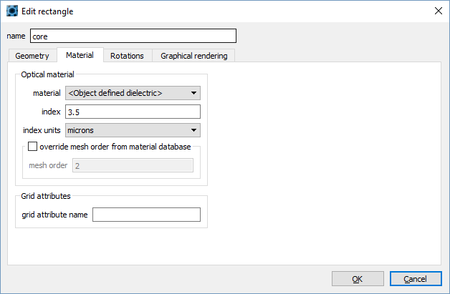
Create waveguide core

Slide 26
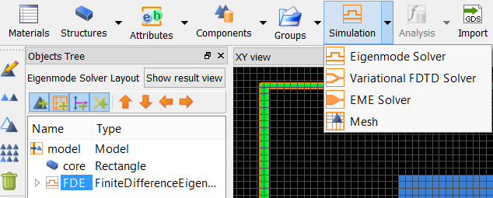
Create 1-D FDE simulation region

Slide 27
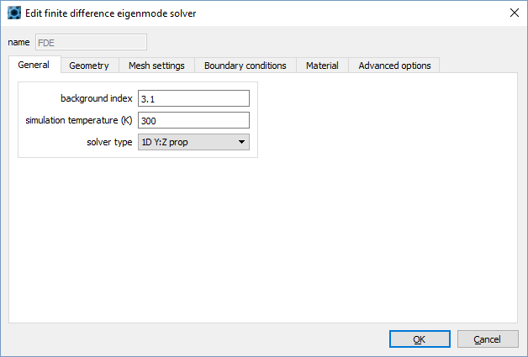
Create 1-D FDE simulation region

Slide 28
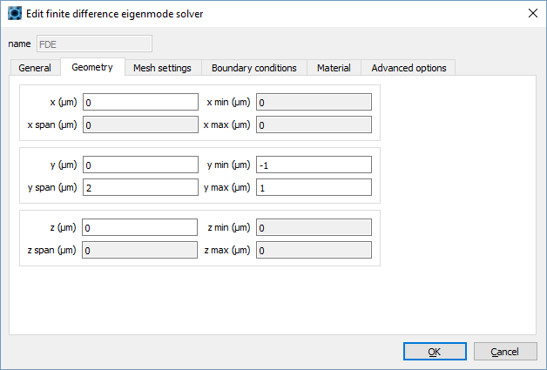
Create 1-D FDE simulation region

Slide 29
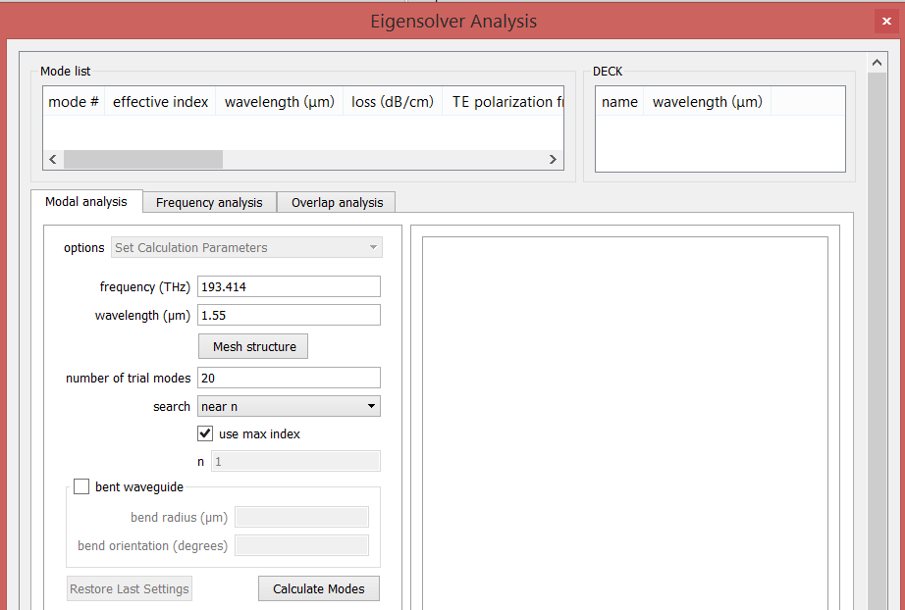
Calculate modes
Click Run
Set wavelength to 1.55 and click Calculate Modes

Slide 30
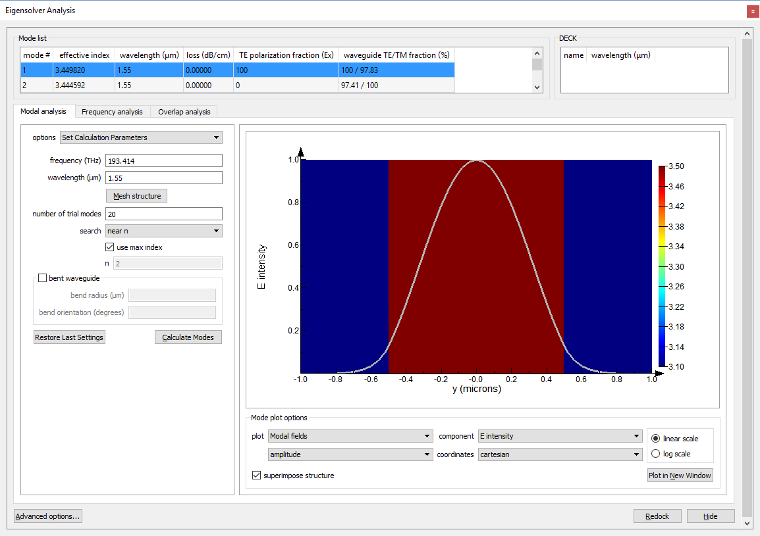
Mode list
Field profile

Slide 31
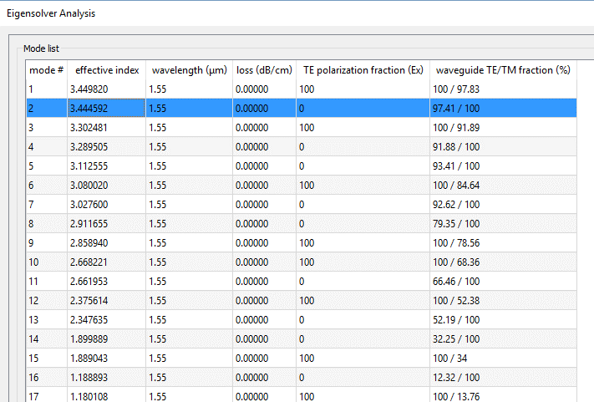
Mode analysis
There are a lot of modes here! But remember, not all of these modes are guided. Only modes with $n_{eff}>n_{clad}=3.1$ are guided modes
Guided modes
Unguided radiating modes

Slide 32
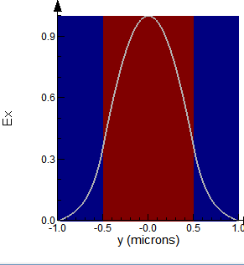
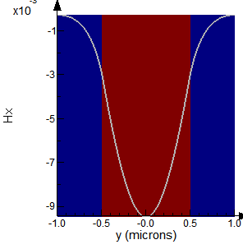
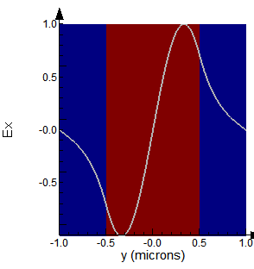
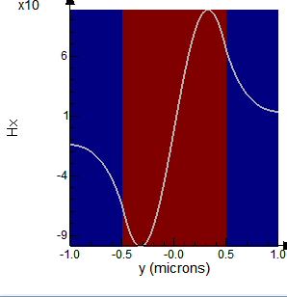
Mode analysis (guided modes)
TE₀
TM₀
TE₁
TM₁

Slide 33
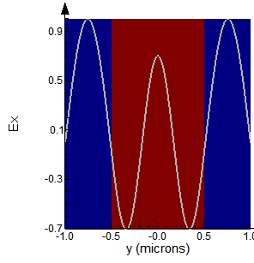
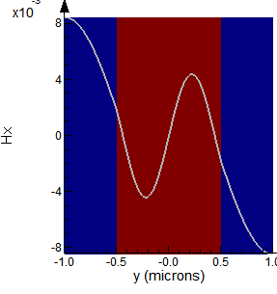
Mode analysis (unguided modes)
Notice: There is no exponential decay in the cladding! Power will be radiated
into the cladding as these unguided “modes” propagate down waveguide
Example #1
Example #2

Slide 34
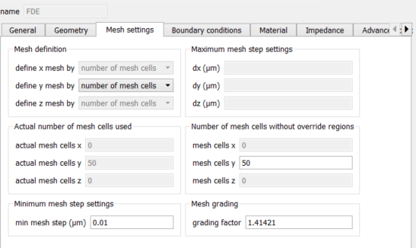
Waveguide cutoff
Let’s run a parameter sweep to plot effective index as a function of slab core thickness
Set minimum mesh spacing to 10nm to speed up analysis
Right-click FDE > Edit > Mesh settings

Slide 35
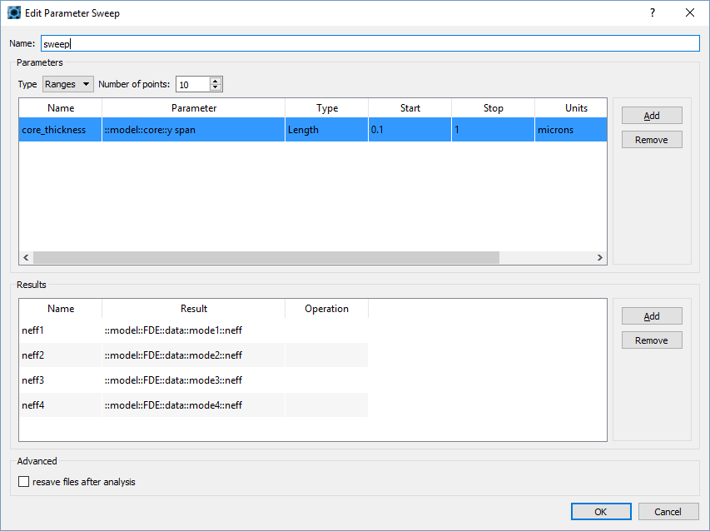
Waveguide cutoff

Slide 36
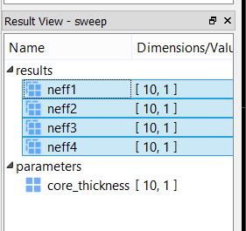
Waveguide cutoff
Click run button:
When done, select sweep, select all results in Result View (bottom left), right click > Visualize > New Visualizer

Slide 37
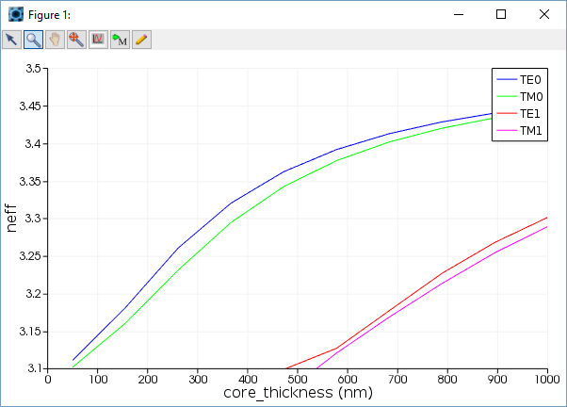
Waveguide cutoff
n_{core}
No cutoff for
TE0, TM0
TE1, TM1 cutoff
Single-mode condition:
$$k_{0}d\sqrt{n_{1}^{2}−n^{2}}<π$$
$→ d$ = 477 nm
n_{cladding}
See Chuang 7.1.2

Slide 38
Next time
Calculate silicon photonic waveguide modes (demo)
Using mode port source in Lumerical FDTD (demo)

